Slide 1


PORTOFOLIO
ABRIAN GIANTARA

Slide 2

CONTENT
01
INTRODUCTION
02
RESUME
03
COVER LETTER
04
MY WORK
05
PRE. PROJECTS
06
OTHER

Slide 3
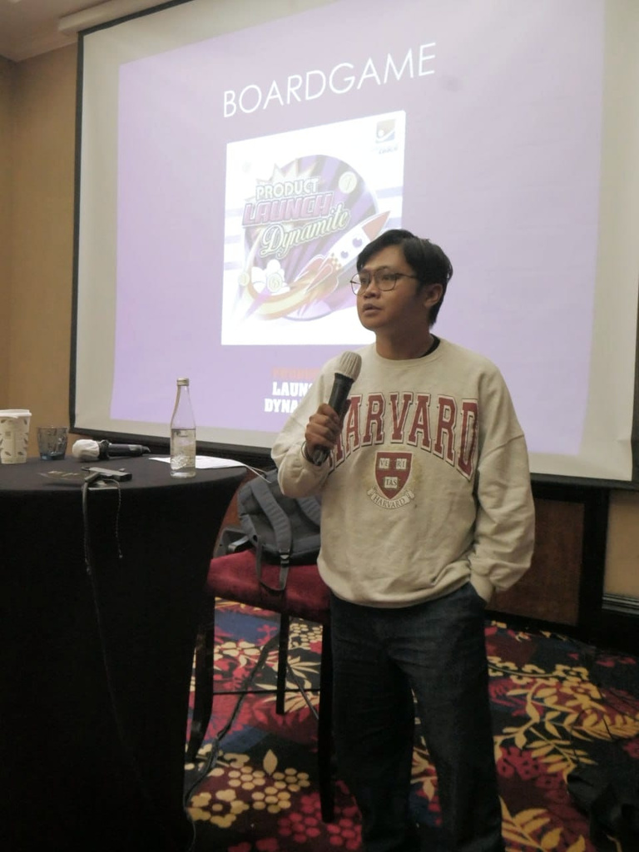



INTRODUCTION
As a seasoned professional with 15 years of diverse experience I offer a unique blend of skills that bridge language proficiency with strategic growth initiatives. With a solid foundation in English education, I possess strong communication, writing, and critical thinking skills essential for effective business development and product consultant .
My extensive tenure in business development has equipped me with the ability to identify opportunities, cultivate relationships, and drive revenue growth. I've successfully navigated complex markets, leveraging my language expertise to communicate effectively with diverse stakeholders and negotiate favourable outcomes.

Slide 4





THINGS TO INCLUDE
Work Sample
Skills
Prof. Narrative

Slide 5

WORK SAMPLE
HIV Prevention Product Development
(Jawa Barat, Indonesia)
I was involved in the development of a product aimed at preventing the transmission of HIV/AIDS in vulnerable areas in West Java. This project involved intensive research, formulation development, clinical trials, and product launch. I participated in various stages of product development, from planning to the implementation of effective marketing strategies to ensure that our product could be accessed by the communities in need.
Product Expansion in African Countries
( PTPN VIII BUMN )
I successfully expanded the reach of our products to several countries in Africa. This expansion process involved in-depth market analysis, negotiations with local partners, and the development of efficient distribution strategies. I played an active role in identifying new market opportunities, overcoming regulatory barriers, and building strong relationships with stakeholders in each of the targeted countries.

Slide 6

SKILLS
Adaptability
Change Management
Market Research
Business Presentation
Analytical Skills
Project Management
Business Strategy
Problem Solving Abilities
Relationship Building
Leadership
Product Consultant

Slide 7
PROF. NARRATIVE
In 2017, I had the honour of receiving the award for Best Product Consultant in Indonesia. This recognition was bestowed upon me during the annual Southeast Asia conference held in Bali. The event served as a gathering of professionals from across the region, providing a platform for sharing insights, discussing industry trends, and celebrating excellence.
As a product consultant, I was deeply committed to delivering innovative solutions and exceeding client expectations. My dedication to understanding market dynamics, collaborating with stakeholders, and leveraging my expertise led to the successful development and implementation of strategies that propelled our products to the forefront of the industry.
Receiving the award served as validation of my hard work and dedication to my craft. It also reinforced my commitment to continuous improvement and excellence in everything I do. This achievement remains a proud moment in my career journey, motivating me to strive for even greater heights in the future.

Slide 8
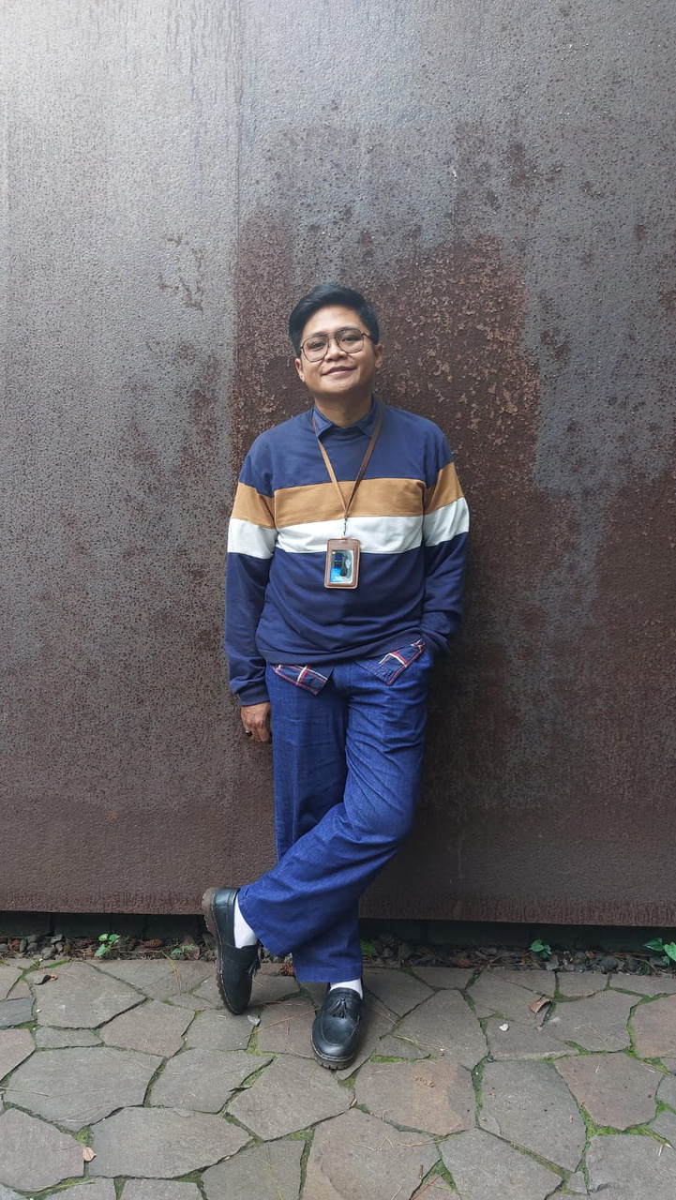
RESUME

Slide 9
“I always strive for excellence.
I believe in the power of collaboration, and I love to build meaningful relationships”

Slide 10
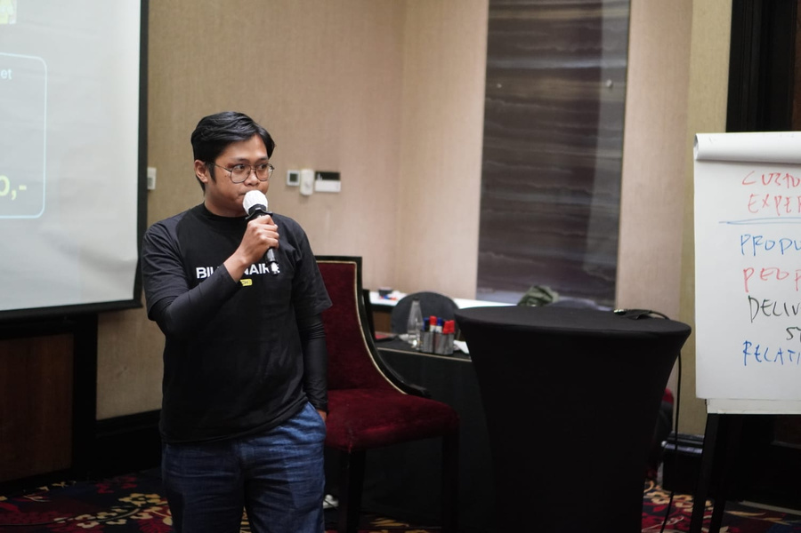
EDUCATION
2011-2016
STKIP Siliwangi, Bandung
Bachelor of English Education

Slide 11
Business Development Executive
PT. Billionaire Coach Indonesia | Oct’23 - Present
Develop and communicate a compelling vision for the company, Monitor financial performance and implement cost effective measures, Ensure profitability and sustainability of the business, and also Uphold and enhance the company's reputation in the market.
Head of Division
PT. Omega Online Transportasi | Apr-Oct’23
Develop and implement strategic plans for the transportation subdivision in alignment with the overall goals and objective of the organization, also supervise and lead a team of transportations professional, ensuring effective communications, collaboration and productivity.
Business Development Executive
PTPN VIII (BUMN) | Dec’21 - Apr’23
Developing and implementing business development strategies and in alignment with the company's overall goals and objective, and I'm identifying and targeting potentials clients, building relationship, and converting leads into sales or partnership, Identifying innovative ways to expand the company's market presence and revenue streams.
EXPERIENCE
Senior Product Consultant
Himalaya Drugs Company | Jun’18 - Nov’21
Developing and and implementing product strategies that align with the company's goals and market demands, collaborating with cross functional teams, Analyzing data and metrics to evaluate product performance and make data driven decision for improvement. This is foreign company so we have to adapting product for international market, considering cultural nuances and managing diverse client bases.
Medical Representatif
Himalaya Drugs Company | Jun’16 - May’18
Assist healthcare professionals in procuring medical supplies, Develop client relations and partnerships to represent company to public, and provide product education to healthcare professionals.

Slide 12



PREVIOUS PROJECTS
“My main role of a product consultant is multifaceted and requires a combination of technical expertise, market knowledge, and strategic thinking to drive the success of the product in the market”.
“As a business development professional, my role is to identify, exploit, and manage business growth opportunities effectively, thereby supporting the achievement of the company's strategic ”
PRODUCT CONSULTANT
BUSINESS DEVELOPMENT

Slide 13
COVER LETTER
WELCOME TO MY PORTFOLIO!
I’m Abrian Giantara, Throughout my career, I have consistently demonstrated a keen understanding of market dynamics and a proven track record of successfully identifying and capitalizing on business opportunities. I have had the privilege of working with diverse teams across various industries, allowing me to refine my skills in creating and executing effective business development strategies. Here you will find everything ranging from writing samples, photographs, videos and more. I strive for excellence in all that I do, and this portfolio serves as a testament to my capabilities and accomplishments.
Have a look around, get to know me better, and don't hesitate to reach out if you have any questions or would like to collaborate!
Sincerely,
Abrian Giantara
+62821-1522-6476 | abriangiantara30@gmail.com

Slide 14
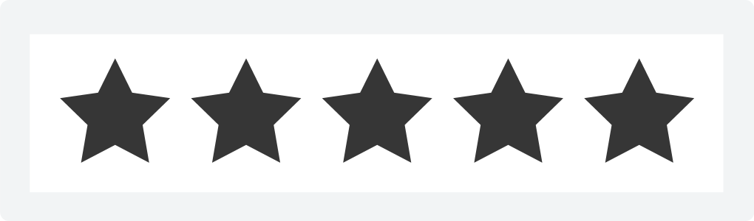
WHAT PEOPLE SAY ABOUT ME
Employer 1
“I have been impressed by the quality, attention to detail and creative approach brought to every project made”
Employer 3
“Projects and campaigns are always taken to another level with ideas that come from this person. Digital marketing and content creation experience is quite evident”
Employer 2
“This person has a strong technical understanding in order to develop successful strategies. Highly recommended for any kind of project or task”
Employer 4
“As business development highly recommended because our work as marketing very helpfull”

Slide 15
NEXT PROJECT
“I possess leadership abilities that have been sharpened through past roles where I was responsible for the teams”
“My problem-solving capabilities have enabled me to solve difficult issues in the past, using creative and innovative solutions”
“With excellent verbal and written skills, I can effectively convey complex messages to a variety of audiences"
LEADERSHIP
PROBLEM-SOLVING
COMMUNICATIONS
“My proactivity allows me to plan ahead and prioritize tasks according to objectives and different deadlines"
“I am knowledgeable in several technical areas such as programming languages that support my ambition in my field"
“Teamwork is one of the essential part of my daily job, and I am sensitive towards different cultures"
ORGANIZATION
TECHNICAL SKILL
INTERP. SKILL

Slide 16









HOW DID I ACHIEVE SUCCESS?
STEP 1
STEP 2
STEP 3
STEP 4
Identifying objectives
Res. and preparation
Developing strategies
Plans of action
STEP 5
STEP 6
STEP 7
STEP 8
Identifying objectives
Res. and preparation
Developing strategies
Plans of action

Slide 17

THANK'S FOR WATCHING
Do you have any question
abriangiantara30@gmail.com
+62821-1522-6476
www.linkedin.com/in/abrian-giantara-847669131

